Slide 1
PRODUCT RECALLS
Identification of unsafe products
January - February 2023

Slide 2
January

Slide 3
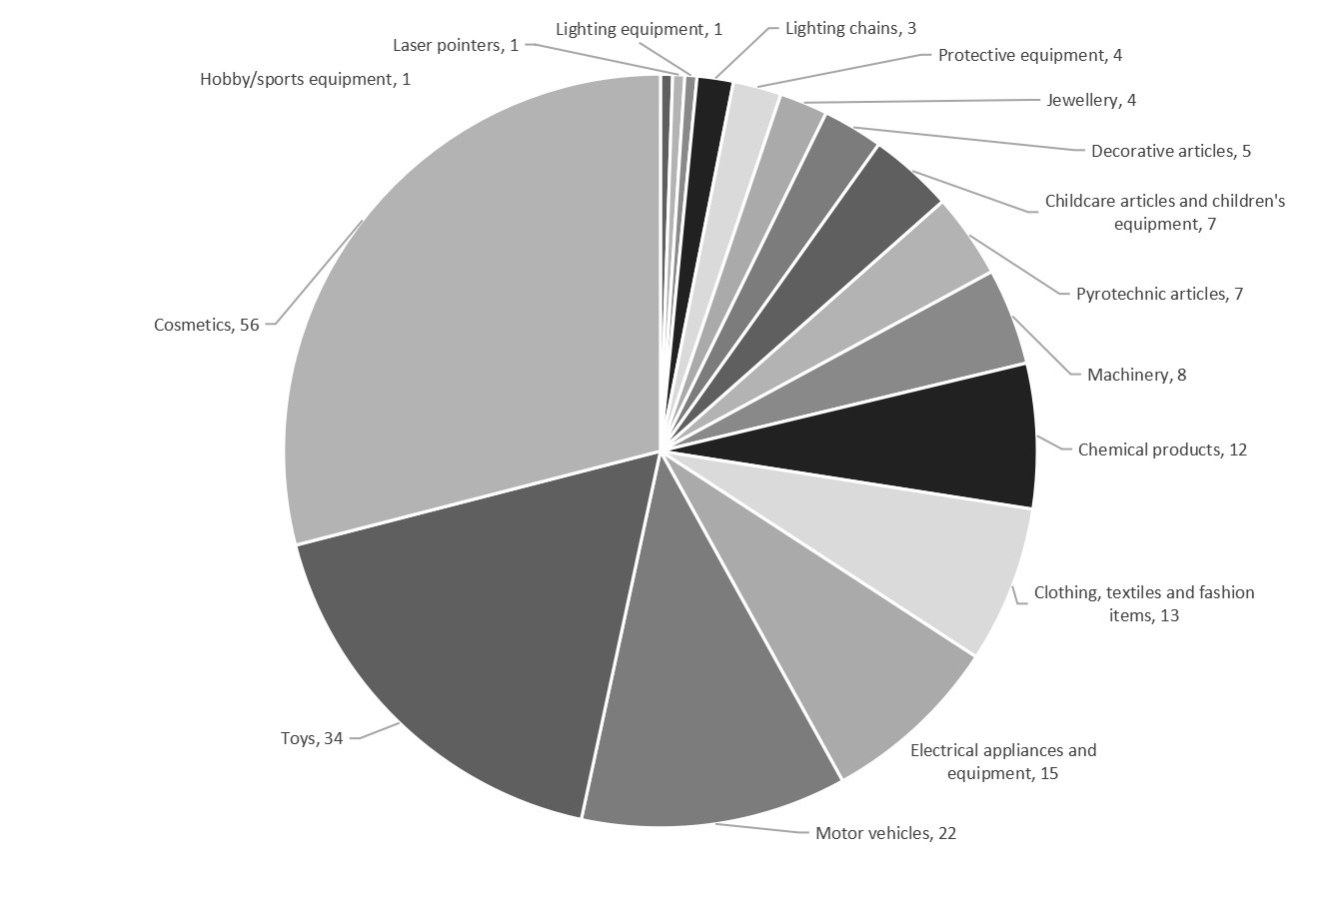
EU (RAPEX)
Summary
In Jan. 2023, the EU recalled 193 products in 16 categories. The most recalled products corresponded to three categories – Cosmetics(56) , Toys(34), Motor vehicles (22). Most of the recalled products came from China (80). And the main risks were chemical(87) and injuries(29). The chart on the right shows the breakdown per product category.
概要
2023年1月欧盟RAPEX预警通报共涉及16类193款产品，被通报产品类别主要集中在化妆品（56例）, 玩具（34例）,机动车辆（22例)。被通报的产品中，原产地为中国（80例），占比43.2%。而主要风险类型为化学伤害（87例），物理伤害（29例）,两者合计占比62.4%；右图反映了召回产品类别的各自占比。

Slide 4
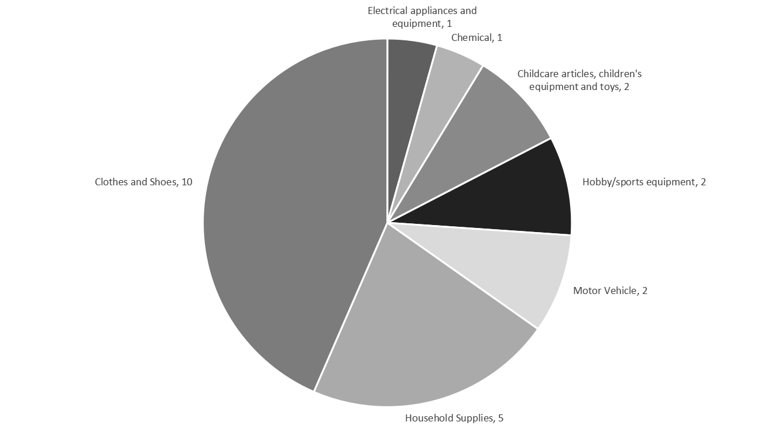
USA (CPSC)
Summary
In Jan. 2023, the US recalled 23 products in 7 categories. The most recalled products corresponded to two categories – Clothes and Shoes(10) and Household Supplies(5). Most of the recalled products came from the China (17). And the main risks were serious burn injuries(10), injury hazard(5). The chart on the right shows the breakdown per product category.
概要
2023年1月，美国CPSC共召回了7类23种产品。被通报产品类别主要集中在鞋服产品（10例）, 家居用品（5例）。被召回的产品中，原产地为中国（178例），占比73.9%；而最主要的风险类型集中在火灾受伤隐患(10例)，物理伤害隐患(5例)。三者合计占比，65.2%; 右图反映了召回产品类别的各自占比。

Slide 5
EU - Monthly Overview Report – Jan. 2023
No. | Alert submitted by | Alert Number | Country Of Origin | Product | Risk type | Risk
1 | Italy | A12/00008/23 | Unknown | Hairspray | Chemical | According to the list of ingredients, the product contains butylphenyl methylpropional (BMHCA) which is forbidden in cosmetic products. BMHCA may harm the reproductive system, may harm the health of the unborn child and may cause skin sensitisation.
2 | Italy | A12/00007/23 | Unknown | Perfume | Chemical | According to the list of ingredients, the product contains butylphenyl methylpropional (BMHCA) which is forbidden in cosmetic products. BMHCA may harm the reproductive system, may harm the health of the unborn child and may cause skin sensitisation.
3 | Italy | A12/00006/23 | Unknown | Perfume | Chemical | According to the list of ingredients, the product contains butylphenyl methylpropional (BMHCA) which is forbidden in cosmetic products. BMHCA may harm the reproductive system, may harm the health of the unborn child and may cause skin sensitisation.
4 | Italy | A12/00005/23 | Unknown | Aftershave | Chemical | According to the list of ingredients, the product contains butylphenyl methylpropional (BMHCA) which is forbidden in cosmetic products. BMHCA may harm the reproductive system, may harm the health of the unborn child and may cause skin sensitisation.
5 | Italy | A12/00004/23 | Unknown | Aromatic perfume | Chemical | According to the list of ingredients, the product contains butylphenyl methylpropional (BMHCA) which is forbidden in cosmetic products. BMHCA may harm the reproductive system, may harm the health of the unborn child and may cause skin sensitisation.
6 | Finland | A12/00018/23 | People's Republic of China | Head band with LED lights | Chemical | The battery compartment is easily opened, leaving the button batteries accessible. A child could put them in the mouth, which could cause damage to the child’s gastrointestinal tract if swallowed.
7 | Poland | A12/00011/23 | People's Republic of China | Set of plastic toys | Chemical | The toy contains an excessive concentration of bis(2-ethylhexyl) phthalate (DEHP) and dibutyl phthalate (DBP) (measured values up to 0.57% and 3.19% by weight, respectively). These phthalates may harm the health of children, possibly causing damage to their reproductive system.
8 | Poland | A12/00013/23 | People's Republic of China | Plastic ball | Chemical | The toy contains an excessive amount of diisobutyl phthalate (DIBP) (measured value up to: 36%). This phthalate may harm the health of children, possibly causing damage to their reproductive system.

Slide 6
EU - Monthly Overview Report – Jan. 2023
No. | Alert submitted by | Alert Number | Country Of Origin | Product | Risk type | Risk
9 | Germany | A11/00002/23 | Germany | Primer | Chemical | The product lacks a hazard label as well as required warnings and pictograms. Users therefore have no information about the safe use and the dangers of the product and can become exposed to skin sensitisation, damage to the organs and eyes and suffer harm the reproductive system.
10 | France | A12/00030/23 | United Kingdom | Climbing chalk | Chemical | The labelling and packaging of this product disregard the risks inherent in its use. The user is not properly informed that this product contains rosin which may cause dermatitis, skin and eye irritation to sensitized users.
11 | Italy | A12/00082/23 | Unknown | Perfume | Chemical | According to the list of ingredients, the product contains butylphenyl methylpropional (BMHCA) which is forbidden in cosmetic products. BMHCA may harm the reproductive system, may harm the health of the unborn child and may cause skin sensitisation.
12 | Italy | A12/00052/23 | Unknown | Perfume | Chemical | According to the list of ingredients, the product contains butylphenyl methylpropional (BMHCA) which is forbidden in cosmetic products. BMHCA may harm the reproductive system, may harm the health of the unborn child and may cause skin sensitisation.
13 | Italy | A12/00074/23 | Unknown | Perfume | Chemical | According to the list of ingredients, the product contains butylphenyl methylpropional (BMHCA) which is forbidden in cosmetic products. BMHCA may harm the reproductive system, may harm the health of the unborn child and may cause skin sensitisation.
14 | Italy | A12/00085/23 | Unknown | Perfume | Chemical | According to the list of ingredients, the product contains butylphenyl methylpropional (BMHCA) which is forbidden in cosmetic products. BMHCA may harm the reproductive system, may harm the health of the unborn child and may cause skin sensitisation.
15 | Italy | A12/00077/23 | Unknown | Perfume | Chemical | According to the list of ingredients, the product contains butylphenyl methylpropional (BMHCA) which is forbidden in cosmetic products. BMHCA may harm the reproductive system, may harm the health of the unborn child and may cause skin sensitisation.
16 | Italy | A12/00076/23 | Unknown | Perfume | Chemical | According to the list of ingredients, the product contains butylphenyl methylpropional (BMHCA) which is forbidden in cosmetic products. BMHCA may harm the reproductive system, may harm the health of the unborn child and may cause skin sensitisation.

Slide 7
EU - Monthly Overview Report – Jan. 2023
No. | Alert submitted by | Alert Number | Country Of Origin | Product | Risk type | Risk
17 | Italy | A12/00078/23 | Unknown | Perfume | Chemical | According to the list of ingredients, the product contains butylphenyl methylpropional (BMHCA) which is forbidden in cosmetic products. BMHCA may harm the reproductive system, may harm the health of the unborn child and may cause skin sensitisation.
18 | Italy | A12/00075/23 | Unknown | Perfume | Chemical | According to the list of ingredients, the product contains butylphenyl methylpropional (BMHCA) which is forbidden in cosmetic products. BMHCA may harm the reproductive system, may harm the health of the unborn child and may cause skin sensitisation.
19 | Italy | A12/00080/23 | Unknown | Perfume | Chemical | According to the list of ingredients, the product contains butylphenyl methylpropional (BMHCA) which is forbidden in cosmetic products. BMHCA may harm the reproductive system, may harm the health of the unborn child and may cause skin sensitisation.
20 | Italy | A12/00081/23 | Unknown | Perfume | Chemical | According to the list of ingredients, the product contains butylphenyl methylpropional (BMHCA) which is forbidden in cosmetic products. BMHCA may harm the reproductive system, may harm the health of the unborn child and may cause skin sensitisation.

Slide 8
USA - Monthly Overview Report – Jan. 2023
No. | Alert submitted by | Alert Number | Country Of Origin | Product | Risk | Measures
1 | Quality Bicycle Products | 23-086 | Taiwan | Bicycle handlebars and bicycles | injury hazard | Consumers should immediately stop using the recalled handlebars and bicycles, and bring the recalled handlebars and bicycles to a local bicycle retailer for free installation of a replacement carbon handlebar or an alternative aluminum handlebar.
2 | P.J. Salvage | 23-085 | China | Children’s pajamas | burn injuries | Consumers should immediately take the recalled pajamas away from children, stop using them and contact P.J. Salvage for instructions on how to receive a pre-paid mailer and return the pajamas for a full refund. Consumers who purchased the pajamas directly from P.J. Salvage will be contacted via email and/or postage mail.
3 | Kids2 Reannounces | 23-089 | China | All models of Kids2 Rocking Sleepers | injury hazard | Consumers should stop using the rocking sleeper immediately and contact Kids2 for a refund. It is illegal to sell or distribute the recalled sleepers.
4 | Fisher-Price Reannounces | 23-088 | China | All models of Rock ‘n Play Sleepers | injury hazard | Consumers should stop using the Rock ‘n Play immediately and contact Fisher-Price for a refund or voucher. It is illegal to sell or distribute the recalled sleepers.
5 | BISSELL | 23-091 | China | BISSELL® Cordless Multi-Surface Wet Dry Vacuums Models 2551, 2551W and 25519 | fire hazard | Consumers should immediately stop using the recalled vacuums and contact BISSELL for a free battery pack replacement. Consumers can either take the product to a local BISSELL authorized service center for a free battery pack replacement or schedule a free in-home repair visit from an authorized BISSELL service technician to replace the existing battery pack.
6 | Vanessa and Lily Pond Fire Tables | 23-093 | China | Vanessa and Lily Pond 42-inch Fire Tables | fire hazard | Consumers should immediately stop using the recalled fire tables, make sure the gas tank is OFF, and contact Ove Decors for a free repair kit, including shipping. Consumer will receive a spring hook to keep the hose away from the heat shield and a warning label.
7 | Vaenait Baby | 23-095 | China | Children’s robes | burn injuries | Consumers should immediately take the recalled robes away from children, stop using them and contact Vaenait Baby for a full refund. Consumers who purchased the robes will be asked to destroy the robes by cutting them in half and send the recalling firm a photo of the destroyed garment. Upon receipt of the photo, consumers will be issued a full refund of the purchase price. Vaenait Baby will contact all known purchasers.
8 | Lifetime Brands | 23-096 | China | Hot Chocolate Pots | fire hazard | Consumers should immediately stop using the recalled pots and contact Williams-Sonoma for instructions on how to return the product for a full refund plus a $20 gift card.

Slide 9
February

Slide 10
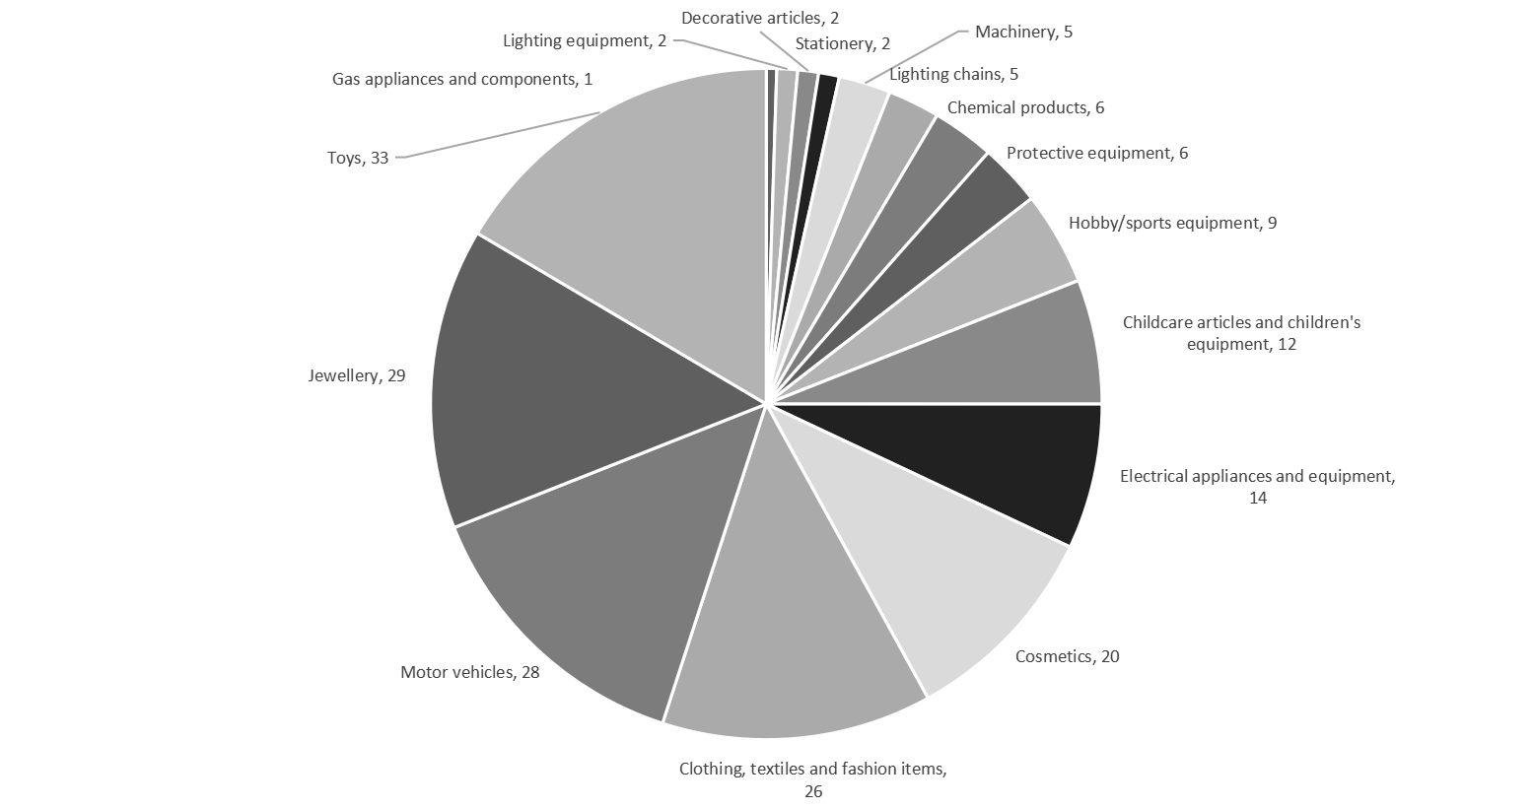
EU (RAPEX)
Summary
In Feb. 2023, the EU recalled 200 products in 16 categories. The most recalled products corresponded to three categories – Toys(33), Jewellery(29) and Motor vehicles (28). Most of the recalled products came from China (109). And the main risks were chemical(82) and injuries(40). The chart on the right shows the breakdown per product category.
概要
2023年2月欧盟RAPEX预警通报共涉及16类200款产品，被通报产品类别主要集中在玩具（33例）, 珠宝首饰（29例），机动车辆（28例）。被通报的产品中，原产地为中国（109例），占比54.5%。而主要风险类型为化学伤害（82例），物理伤害（40例）,两者合计占比60.7%；右图反映了召回产品类别的各自占比。

Slide 11
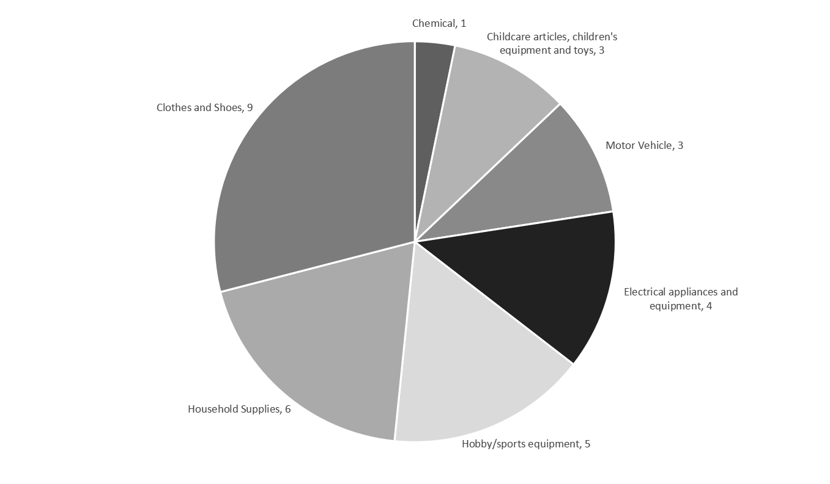
USA (CPSC)
Summary
In Feb. 2023, the US recalled 31 products in 7 categories. The most recalled products corresponded to three categories – Clothes and Shoes(9), Household Supplies(6) and Hobby/Sports Equipment(5). Most of the recalled products came from the China (17). And the main risks were serious burn injuries(7), choking hazard(3), injury hazards(3). The chart on the right shows the breakdown per product category.
概要
2023年2月，美国CPSC共召回了7类31种产品。被通报产品类别主要集中在鞋服产品（9例）,家居用品（6例）娱乐运动设备（5例）。被召回的产品中，原产地为中国（17例），占比54.8%；而最主要的风险类型集中在火灾受伤隐患(7例)，窒息隐患(3例)，物理伤害隐患(3例)。三者合计占比，43.3%; 右图反映了召回产品类别的各自占比。

Slide 12
EU - Monthly Overview Report – Feb. 2023
No. | Alert submitted by | Alert Number | Country Of Origin | Product | Risk type | Risk
1 | Ireland | A12/00208/23 | India | Hair dye | Chemical | According to the list of ingredients, the product contains sodium perborate, which releases boron and is forbidden in cosmetic products. Ingestion or contact with an excessive quantity of boron may harm the health by damaging the reproductive system or the unborn child.
2 | Italy | A12/00205/23 | Unknown | Ring | Chemical | The product has an excessive concentration of cadmium (measured value 17,7% by weight). Cadmium is harmful to human health because it accumulates in the body, can damage the kidneys and bones, and it may cause cancer.
3 | Italy | A12/00206/23 | Unknown | Bracelet | Chemical | The product has an excessive concentration of cadmium (measured value 18,8% by weight). Cadmium is harmful to human health because it accumulates in the body, can damage the kidneys and bones, and it may cause cancer.
4 | Italy | A12/00207/23 | Unknown | Bracelet | Chemical | The product has an excessive concentration of cadmium (measured value 19,8% by weight). Cadmium is harmful to human health because it accumulates in the body, can damage the kidneys and bones, and it may cause cancer.
5 | Italy | A12/00209/23 | Unknown | Earrings | Chemical | The product has an excessive concentration of lead. Lead is harmful to human health, accumulates in the body, can cause developmental neurotoxicity and may also affect breast-fed or unborn children.
6 | Ireland | A12/00188/23 | People's Republic of China | Earrings | Chemical | The product has an excessive concentration of cadmium (measured value up to 87% by weight). Cadmium is harmful to health. It accumulates in the body, can damage the kidneys and bones and cause cancer.
7 | Ireland | A12/00189/23 | People's Republic of China | Earrings | Chemical | The product has an excessive concentration of cadmium (measured value up to 87% by weight). Cadmium is harmful to health. It accumulates in the body, can damage the kidneys and bones and cause cancer.
8 | Ireland | A12/00187/23 | People's Republic of China | Neck collar | Chemical | The product has an excessive concentration of lead (measured value: 2.5% by weight). Lead is harmful to human health, accumulates in the body, can cause developmental neurotoxicity and may also affect breast-fed or unborn children.

Slide 13
EU - Monthly Overview Report – Feb. 2023
No. | Alert submitted by | Alert Number | Country Of Origin | Product | Risk type | Risk
9 | Ireland | A12/00186/23 | People's Republic of China | Necklace with pendant | Chemical | The product has an excessive concentration of cadmium (measured value up to 0.15% by weight). Cadmium is harmful to health. It accumulates in the body, can damage the kidneys and bones and cause cancer.
10 | Ireland | A12/00192/23 | People's Republic of China | Bracelet | Chemical | The product has an excessive concentration of lead (measured value: up to 31% by weight). Lead is harmful to human health, accumulates in the body, can cause developmental neurotoxicity and may also affect breast-fed or unborn children.
11 | Ireland | A12/00191/23 | People's Republic of China | Ankle bracelet | Chemical | The product has an excessive concentration of cadmium (measured value: up to 77.6% by weight). Cadmium is harmful to health. It accumulates in the body, can damage the kidneys and bones and cause cancer.
12 | Ireland | A12/00193/23 | People's Republic of China | Necklace | Chemical | The product has an excessive concentration of cadmium (measured value: up to 87% by weight). Cadmium is harmful to health. It accumulates in the body, can damage the kidneys and bones and cause cancer.
13 | Lithuania | A12/00190/23 | Poland | Face and body cream | Chemical | According to the list of ingredients the product contains butylphenyl methylpropional (BMHCA), which is forbidden in cosmetic products. BMHCA may harm the reproductive system, may harm the health of the unborn child and may cause skin sensitisation.
14 | Italy | A12/00231/23 | People's Republic of China | Children's bag | Chemical | The plastic material of the product has an excessive concentration of bis(2-ethylhexyl) phthalate (DEHP) (measured value up to 10.2% by weight). This phthalate may harm the health of children, possibly causing damage to their reproductive systems
15 | Italy | A12/00230/23 | People's Republic of China | Plastic book | Chemical | The plastic material of the product has an excessive concentration of bis(2-ethylhexyl) phthalate (DEHP) (measured value up to 2.2% by weight). This phthalate may harm the health of children, possibly causing damage to their reproductive systems.
16 | Italy | A12/00222/23 | People's Republic of China | Wristwatch | Chemical | The wriststrap has an excessive concentration of bis(2-ethylhexyl) phthalate (DEHP) (measured value up to 2% by weight). This phthalate may harm the health of children, possibly causing damage to their reproductive systems.

Slide 14
EU - Monthly Overview Report – Feb. 2023
No. | Alert submitted by | Alert Number | Country Of Origin | Product | Risk type | Risk
17 | Cyprus | A12/00235/23 | People's Republic of China | Gym weight | Chemical | The plastic material of the product has an excessive concentration of bis(2-ethylhexyl) phthalate (DEHP) (measured value up to 41% by weight). This phthalate may harm the health of children, possibly causing damage to their reproductive systems.
18 | Austria | A12/00238/23 | Austria | Hair dye | Chemical | According to the list of ingredients, the product contains Barium peroxide, which is forbidden in cosmetics and releases barium; the latter substance was found in the product (measured value: 7.8% by weight). Barium can be easily absorbed and has toxic effects on the body impairing muscle, heart and kidney activity, leading to arrythmia, paralysis or gastrointestinal alterations. Furthermore, the product contains p-phenylenediamine (PPD) (measured value: 12.64% by weight) with an insufficient coupling agent. Uncoupled PPD is an extreme skin sensitiser and can trigger allergic contact dermatitis.
19 | Austria | A12/00239/23 | The Netherlands | Hair dye | Chemical | The product contains sodium perborate (as declared on the packaging), which releases boron (measured value: 21.4 mg/kg) and is forbidden in cosmetic products. Additionally, the product contains p-phenylenediamine (PPD) (measured value: 12.76 % by weight). Ingestion or contact with an excessive quantity of boron may harm the health by damaging the reproductive system or the unborn child. PPD is an extreme skin sensitiser and can trigger allergic contact dermatitis.
20 | Italy | A12/00229/23 | People's Republic of China | Ring | Chemical | The product releases an excessive amount of nickel (measured value up to 18.64 μg/cm²/week). Nickel is a strong sensitiser and can cause allergic reactions if present in articles that come into direct and prolonged contact with the skin.

Slide 15
USA - Monthly Overview Report – Feb. 2023
No. | Alert submitted by | Alert Number | Country Of Origin | Product | Risk | Measures
1 | Betsy & Lace | 23-123 | China | Children’s nightgowns | burn injuries | Consumers should immediately take the recalled nightgowns away from children, stop using them and destroy the nightgowns by cutting them in half. Betsy & Lace is contacting all known purchasers directly.
2 | Hatley USA | 23-122 | China | Children’s pajamas and headbands | burn injuries | Consumers should immediately take the recalled products away from children, stop using them and contact Hatley USA for a full refund. Consumers can also return the recalled products to any Hatley USA store. Hatley USA is contacting all known purchasers directly.
3 | Children’s Nightgowns | 23-121 | China | Children’s nightgowns | burn injuries | Consumers should immediately take the recalled nightgowns away from children, stop using them and contact Oaks Apparel for a full refund.
4 | Allpredatorcalls.com | 23-120 | China | Wicked Lights ScanPro Night Hunting Headlamps | burn hazard | Consumers should immediately stop using the recalled headlamps and contact AllPredatorCalls.com for a repair in the form of a free replacement battery compartment with a safety power circuit.
5 | Linus Bike | 23-727 | China | Electric bicycles | crash hazard | Consumers should immediately stop using the recalled bicycles and contact Linus Bike to schedule a free fork replacement. Linus is contacting all known purchasers directly.
6 | WeeSprout | 23-724 | China | Baby Sleep Sacks | choking hazard | Consumers should immediately stop using, take the recalled sleep sack and cut it in half with a pair of scissors, take a photo of it, and discard it in the household trash. Contact WeeSprout to receive a $17 refund or credit in the form of a gift card. Email a photo documenting that the sleep sack has been destroyed along with your contact information to weecare@weesprout.com to receive the refund or credit. WeeSprout is contacting all known purchasers.
7 | Skip Hop | 23-117 | China | Silver Lining Cloud Activity Gyms | choking hazard | Consumers should immediately remove the raindrops on the cloud toy by cutting them off with a pair of scissors, take a photo of the cloud toy with the raindrops removed, discard the raindrops in the household trash, and submit the photo of the cloud toy with the raindrops cut off at www.skiphoprecall.com. Upon receipt of the photo, consumers will be issued a $10 Skip Hop gift card and a free shipping code.
8 | Children’s Robes | 23-113 | China | Children’s Robes | burn injuries | Consumers should immediately take the recalled robes away from children, stop using them and contact SGMWVB for a full refund. Consumers who purchased the robes will be asked to destroy the garments by cutting them in half and send SGMWVB a photo of the destroyed robe by email. SGMWVB and Amazon are contacting all known purchasers directly.

Slide 16
SOURCES
HQTS Group Product Recall lists mandatory and voluntary consumer product recalls published by:
The European Union Rapid Alert System for dangerous non-food products (RAPEX)
The US Consumer Product Safety Commission (CPSC)

Slide 17


