Slide 1
PRODUCT RECALLS
Identification of unsafe products
March 2023

Slide 2
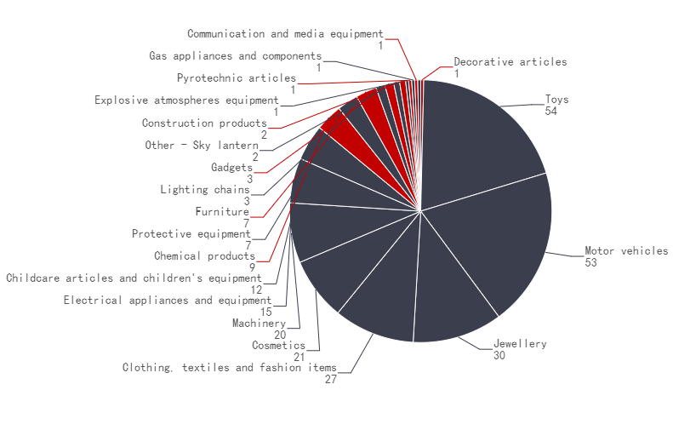
EU (RAPEX)
Summary
In Mar. 2023, the EU recalled 271 products in 21 categories. The most recalled products corresponded to three categories – Toys(54), Motor vehicles (53) , Jewellery(30). Most of the recalled products came from China (127). And the main risks were chemical(100) and injuries(68). The chart on the right shows the breakdown per product category.
概要
2023年3月欧盟RAPEX预警通报共涉及21类271款产品，被通报产品类别主要集中在玩具（54例）,机动车辆（53例)，珠宝(30例)。被通报的产品中，原产地为中国（127例），占比46.9%。而主要风险类型为化学伤害（100例），物理伤害（68例）,两者合计占比62.0%；右图反映了召回产品类别的各自占比。

Slide 3
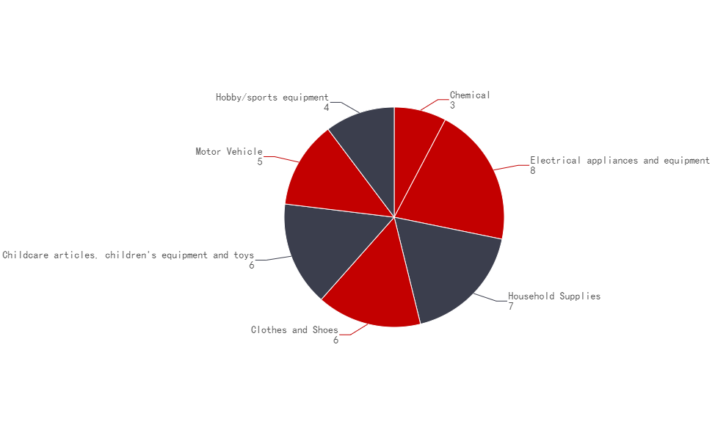
USA (CPSC)
Summary
In Mar. 2023, the US recalled 39 products in 7 categories. The most recalled products corresponded to two categories – Electrical appliances and equipment(8) and Household Supplies(7). Most of the recalled products came from the China (20). And the main risks were serious fire injuries(5), choking hazard(4). The chart on the right shows the breakdown per product category.
概要
2023年3月，美国CPSC共召回了7类39种产品。被通报产品类别主要集中在电子设备（8例）, 家居用品（7例）。被召回的产品中，原产地为中国（20例），占比51.3%；而最主要的风险类型集中在火灾受伤隐患(5例)，窒息隐患(4例)。两者合计占比，23.1%; 右图反映了召回产品类别的各自占比。

Slide 4
EU - Monthly Overview Report – Mar. 2023
No. | Alert submitted by | Alert Number | Country Of Origin | Product | Risk type | Risk
1 | Italy | INFO/00014/23 | Unknown | Hair clip | Chemical | The product has an excessive concentration of lead (measured value up to 16,6% by weight). Lead is harmful to human health, accumulates in the body, can cause developmental neurotoxicity and may also affect breast-fed or unborn children.
2 | Italy | INFO/00015/23 | Unknown | Hair clip | Chemical | The product has an excessive concentration of lead. Lead is harmful to human health, accumulates in the body, can cause developmental neurotoxicity and may also affect breast-fed or unborn children.
3 | Lithuania | A12/00431/23 | Poland | Hand cream | Chemical | The product has hydroxyisohexyl 3-cyclohexene carboxaldehyde (INCI), which is a skin sensitiser and triggers allergic reactions or contact dermatitis.
4 | Sweden | A12/00411/23 | People's Republic of China | Waist jewellery | Chemical | The center metal plate contains an excessive amount of cadmium (measured values up to 24 % by weight). Cadmium is harmful to health. It accumulates in the body, can damage the kidneys and bones and cause cancer.
5 | Italy | INFO/00016/23 | People's Republic of China | Necklace | Chemical | The product has an excessive concentration of lead. Lead is harmful to human health, accumulates in the body, can cause developmental neurotoxicity and may also affect breast-fed or unborn children.
6 | Czechia | A12/00435/23 | People's Republic of China | Plastic doll | Chemical | The plastic material of the product has an excessive concentration of bis(2-ethylhexyl) phthalate (DEHP) (measured value up to 25.4% by weight). This phthalate may harm the health of children, possibly causing damage to their reproductive systems.
7 | Finland | A12/00422/23 | India | Gloves | Chemical | The product contains chromium VI (measured value: up to 10.3 mg/kg). Chromium (VI) is sensitising, can trigger allergic reactions and can cause cancer.
8 | Finland | A12/00424/23 | Pakistan | Gloves | Chemical | The product contains chromium VI (measured value: 6.3 mg/kg). Chromium (VI) is sensitising, can trigger allergic reactions and can cause cancer.

Slide 5
EU - Monthly Overview Report – Mar. 2023
No. | Alert submitted by | Alert Number | Country Of Origin | Product | Risk type | Risk
9 | Sweden | A12/00445/23 | Unknown | Tattoo ink | Chemical | The product has an excessive concentration of cobalt and nickel (measured values: 16 mg/kg and 12 mg/kg, respectively). Cobalt is a skin and respiratory sensitiser and may cause cancer. Nickel can induce sensitisation or elicit allergic responses.
10 | Sweden | A12/00413/23 | People's Republic of China | Pendant | Chemical | The metal in the pendant has an excessive concentration of cadmium (measured value up to 58% by weight). Cadmium is harmful to human health because it accumulates in the body, can damage the kidneys and bones and it may cause cancer.
11 | Sweden | A12/00414/23 | People's Republic of China | Pendant | Chemical | The metal in the pendant has an excessive concentration of cadmium (measured value up to 20% by weight). Cadmium is harmful to human health because it accumulates in the body, can damage the kidneys and bones and it may cause cancer.
12 | Sweden | A12/00415/23 | People's Republic of China | Pendant | Chemical | The metal in the pendant has an excessive concentration of cadmium (measured value up to 14% by weight). Cadmium is harmful to human health because it accumulates in the body, can damage the kidneys and bones and it may cause cancer.
13 | Sweden | A12/00416/23 | People's Republic of China | Pendant | Chemical | The metal in the pendant has an excessive concentration of cadmium (measured value up to 26% by weight). Cadmium is harmful to human health because it accumulates in the body, can damage the kidneys and bones and it may cause cancer.
14 | Sweden | A12/00417/23 | People's Republic of China | Pendant | Chemical | The metal in the pendant has an excessive concentration of cadmium (measured value up to 39% by weight). Cadmium is harmful to human health because it accumulates in the body, can damage the kidneys and bones and it may cause cancer.
15 | Sweden | A12/00418/23 | People's Republic of China | Brooch | Chemical | The metal in the pendant has an excessive concentration of cadmium (measured value up to 19% by weight). Cadmium is harmful to human health because it accumulates in the body, can damage the kidneys and bones and it may cause cancer.
16 | Sweden | A12/00419/23 | People's Republic of China | Pendant | Chemical | The metal in the pendant has an excessive concentration of cadmium (measured value up to 38% by weight). Cadmium is harmful to human health because it accumulates in the body, can damage the kidneys and bones and it may cause cancer.

Slide 6
EU - Monthly Overview Report – Mar. 2023
No. | Alert submitted by | Alert Number | Country Of Origin | Product | Risk type | Risk
17 | Hungary | A12/00423/23 | People's Republic of China | Cosmetic bag | Chemical | The plastic material of the cosmetic bag contains an excessive amount of bis(2-ethylhexyl) phthalate (DEHP) (measured value up to 6.6% by weight), dibutyl phthalate (DBP) (measured value up to 0.29% by weight) and diisobutyl phthalate (DIBP) (measured value up to 0.22% by weight). These phthalates may harm the health by possibly causing damage to the reproductive system.
18 | Sweden | INFO/00017/23 | People's Republic of China | Bracelet | Chemical | Metal parts in the bracelet have an excessive concentration of lead (measured value up to 5% by weight). Lead is harmful to human health, accumulates in the body, can cause developmental neurotoxicity and may also affect breast-fed or unborn children.
19 | Hungary | A12/00425/23 | People's Republic of China | Cosmetic bag | Chemical | The plastic material of the product contains an excessive amount of bis(2-ethylhexyl) phthalate (DEHP) (measured value: up to 7.9% by weight). This phthalate may harm the health by possibly causing damage to the reproductive system.
20 | Hungary | A12/00443/23 | People's Republic of China | Cosmetic bag | Chemical | The plastic material of the product has an excessive amount of bis(2-ethylhexyl) phthalate (DEHP), measured values up to 26% by weight. This phthalate may harm the health by possibly causing damage to the reproductive system.

Slide 7
USA - Monthly Overview Report – Mar. 2023
No. | Alert submitted by | Alert Number | Country Of Origin | Product | Risk | Measures
1 | TJX | 23-137 | China | Office Chairs | fall hazard | Consumers should immediately stop using the recalled chairs and contact TJX for instructions on how to participate in the recall and dispose of the chairs from home to receive a full refund. Consumers can also return the recalled chairs to any Marshalls, T.J. Maxx, HomeGoods or Homesense store for a full refund.
2 | Primark | 23-139 | China | Children’s Bamboo Plates | health effects | Consumers should immediately take the recalled plates away from children, stop using them and return them to a Primark store for a full refund or consumers can contact Primark for instructions on how to properly dispose of the product to also receive a full refund.
3 | Epoch Everlasting Play | 23-150 | China | Calico Critters® Animal Figures and Sets sold with Bottle and Pacifier Accessories | choking hazard | Consumers should immediately take the recalled bottle and pacifier accessories away from children and contact Epoch Everlasting Play LLC for instructions on how to submit a photo of the recalled bottle and/or pacifier accessory along with contact information and confirmation of destruction to receive a free replacement accessory.
4 | Smocked Runway | 23-731 | China | Classic Whimsy children’s pajamas | burn injuries | Consumers should immediately take the recalled children’s pajamas away from children, stop using them and contact Smocked Runway for instructions on how to receive a pre-paid mailer and return the pajamas for a full refund in the original form of payment or store credit for the original purchase price. Smocked Runway is directly contacting all known purchasers.
5 | Monoprice | 23-736 | China | Pure Outdoor Cooking Systems | fire hazard | Consumers should immediately stop using the recalled outdoor cooking system and contact Monoprice for a full refund. Monoprice is contacting all purchasers directly.
6 | Active Sports | 23-733 | China | CTRL Imperial Wakeboard Bindings | fall hazard | Consumers should immediately stop using the recalled bindings and contact Active Sports for a free replacement product or a refund. The firm is contacting all known purchasers.
7 | Vornado Air | 23-148 | China | SRTH Small Room Tower Heaters | fire hazards | Consumers should immediately stop using the recalled heaters and visit Vornado’s website to register for the recall and to receive a full refund.
8 | Akerson Enterprises | 23-149 | China | Kindred Bravely Bamboo Nursing Hoodies | choking hazard | Consumers should immediately stop using the recalled nursing hoodies, cut the fully extended drawstring cords and discard the cords. Consumers can also request a $75 store credit by filling out an online form at www.kindredbravely.com/pages/bamboo-hoodie-safety-recall and providing a photo of the cut drawstrings cords and company branding.

Slide 8
SOURCES
HQTS Group Product Recall lists mandatory and voluntary consumer product recalls published by:
The European Union Rapid Alert System for dangerous non-food products (RAPEX)
The US Consumer Product Safety Commission (CPSC)

Slide 9


