Slide 1
PRODUCT RECALLS
Identification of unsafe products
April 2023

Slide 2
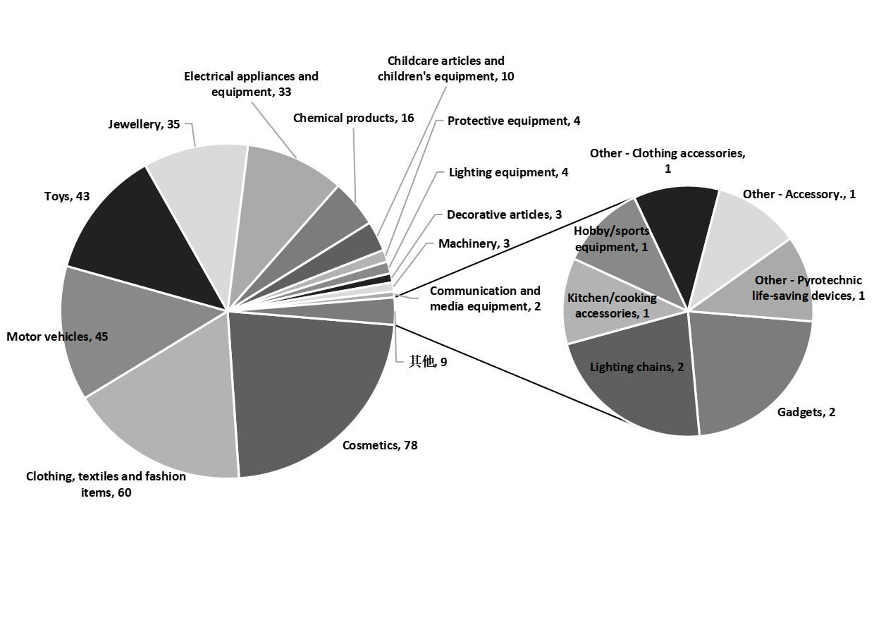
EU (RAPEX)
Summary
In Apr. 2023, the EU recalled 345 products in 20 categories. The most recalled products corresponded to three categories – Cosmetics(78), Clothing, textiles and fashion items (60) , Motor vehicles(45). Most of the recalled products came from China (122). And the main risks were chemical(163) and injuries(57). The chart on the right shows the breakdown per product category.
概要
2023年4月欧盟RAPEX预警通报共涉及20类345款产品，被通报产品类别主要集中在化妆品（78例）,服装、纺织品和时装（60例)，机动车辆(45例)。被通报的产品中，原产地为中国（122例），占比35.4%。而主要风险类型为化学伤害（163例），物理伤害（57例）,两者合计占比63.7%；右图反映了召回产品类别的各自占比。

Slide 3
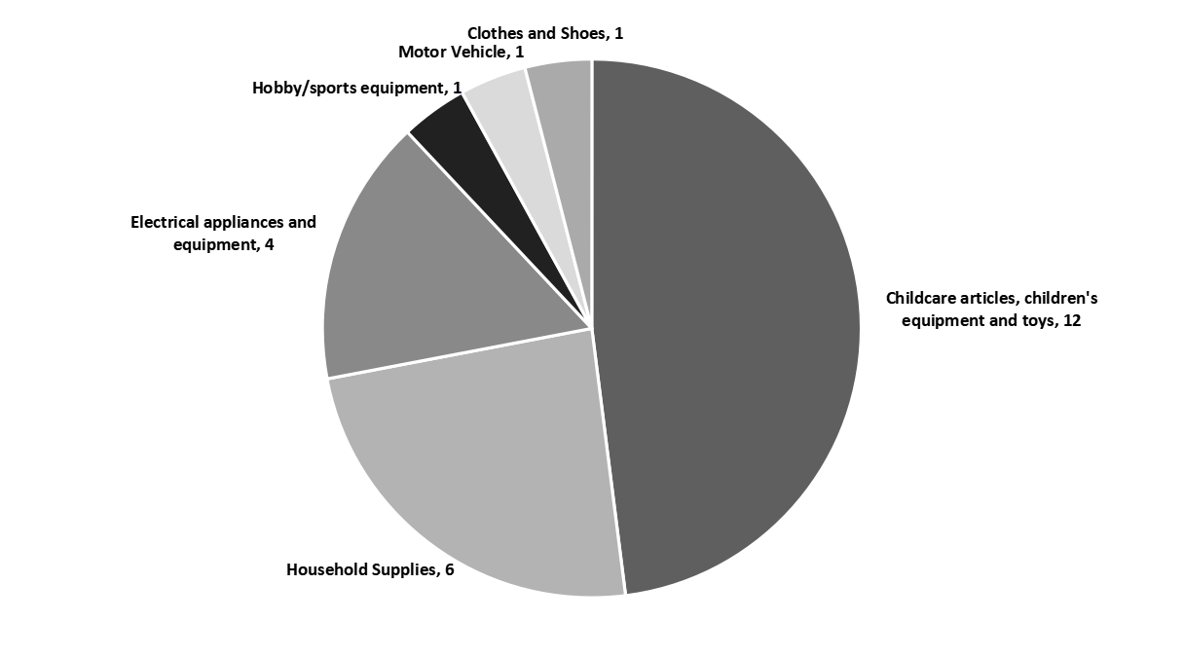
USA (CPSC)
Summary
In Apr. 2023, the US recalled 25 products in 6 categories. The most recalled products corresponded to two categories – Childcare articles, children's equipment and toys(12) and Household Supplies(6). Most of the recalled products came from the China (19). And the main risks were burn injuries to children.(6), hazard to swimmers and bathers.(3). The chart on the right shows the breakdown per product category.
概要
2023年4月，美国CPSC共召回了7类39种产品。被通报产品类别主要集中在儿童用品、儿童用品及玩具（12例）, 家居用品（6例）。被召回的产品中，原产地为中国（19例），占比76%；而最主要的风险类型集中在儿童烧伤(6例)，游泳人士及泳客的危险(3例)。两者合计占比，36%; 右图反映了召回产品类别的各自占比。

Slide 4
EU - Monthly Overview Report – Apr. 2023
No. | Alert submitted by | Alert Number | Country Of Origin | Product | Risk type | Risk
1 | Germany | A12/00681/23 | People's Republic of China | Children’s rings | Chemical | The product has an excessive concentration of cadmium (measured value 67% by weight). Cadmium is harmful to human health because it accumulates in the body, may damage the kidneys and bones, and may cause cancer.
2 | Germany | A12/00680/23 | People's Republic of China | Earrings | Chemical | The product has an excessive concentration of cadmium (measured value 86% by weight). Cadmium is harmful to human health because it accumulates in the body, may damage the kidneys and bones, and may cause cancer.
3 | Germany | INFO/00034/23 | People's Republic of China | Advent calendar | Chemical | The product has an excessive concentration of cadmium (measured value 45 % by weight). Cadmium is harmful to human health because it accumulates in the body, can damage the kidneys and bones and it may cause cancer.
4 | Germany | INFO/00033/23 | Unknown | Jewellery set | Chemical | The product has an excessive concentration of cadmium (measured value: 96% by weight). Cadmium is harmful to human health because it accumulates in the body, may damage the kidneys and bones, and it may cause cancer.
5 | Germany | A12/00679/23 | People's Republic of China | Anklet | Chemical | The product has an excessive concentration of cadmium (measured value 90% by weight). Cadmium is damaging to human health because it accumulates in the body, can damage the kidneys and bones and cause cancer.
6 | Germany | A12/00678/23 | Unknown | Bracelet | Chemical | The product has an excessive concentration of lead (measured value 39% by weight). Lead is harmful to human health, accumulates in the body, can cause developmental neurotoxicity and may also affect breast-fed or unborn children.
7 | Germany | INFO/00037/23 | People's Republic of China | Advent calendar | Chemical | The product has an excessive concentration of cadmium (measured value: 92% by weight). Cadmium is harmful to human health because it accumulates in the body, can damage the kidneys and bones and it may cause cancer.
8 | Germany | INFO/00036/23 | Unknown | Jewellery set | Chemical | The product has an excessive concentration of cadmium (measured value:83% by weight). Cadmium is harmful to human health because it accumulates in the body, can damage the kidneys and bones and it may cause cancer.

Slide 5
EU - Monthly Overview Report – Apr. 2023
No. | Alert submitted by | Alert Number | Country Of Origin | Product | Risk type | Risk
9 | Sweden | A12/00647/23 | Germany | Toy bow | Chemical | The red grip tape on the bow has an excessive concentration of di(2-ethylhexyl)phthalate (DEHP) (measured value up to 6.4% by weight). This phthalate may harm the health of children, possibly causing damage to their reproductive systems.
10 | Romania | A12/00653/23 | Greece | Soap | Chemical | According to the list of ingredients the product contains butylphenyl methylpropional (BMHCA), which is forbidden in cosmetic products. BMHCA may harm the reproductive system, may harm the health of the unborn child and may cause skin sensitisation.
11 | Romania | A12/00660/23 | Italy | Liquid soap | Chemical | According to the list of ingredients, the product contains butylphenyl methylpropional (BMHCA) which is forbidden in cosmetic products. BMHCA may harm the reproductive system and the health of the unborn child as well as causing skin sensitisation.
12 | Cyprus | A12/00666/23 | Belgium | Plastic doll | Chemical | The doll has an excessive concentration of bis(2-ethylhexyl)phthalate (DEHP) (measured values up to 20.79% by weight). This phthalate may harm the health of children, possibly causing damage to their reproductive systems.
13 | Romania | A12/00654/23 | Unknown | Aftershave | Chemical | According to the list of ingredients, the product contains butylphenyl methylpropional (BMHCA) which is forbidden in cosmetic products. BMHCA may harm the reproductive system, may harm the health of the unborn child and may cause skin sensitisation.
14 | Slovakia | A12/00687/23 | People's Republic of China | Plastic doll | Chemical | The plastic material of the toy contains an excessive amount of DEHP (measured value 5.57 % by weight). This phthalate may harm the health of children by possibly causing damage to the reproductive systems.
15 | Romania | A12/00655/23 | Italy | Cream soap | Chemical | According to the list of ingredients, the product contains butylphenyl methylpropional (BMHCA) which is forbidden in cosmetic products. BMHCA may harm the reproductive system and the health of the unborn child as well as causing skin sensitisation.
16 | Romania | A12/00658/23 | Italy | Shower gel | Chemical | According to the list of ingredients, the product contains butylphenyl methylpropional (BMHCA) which is forbidden in cosmetic products. BMHCA may harm the reproductive system and the health of the unborn child as well as causing skin sensitisation.

Slide 6
EU - Monthly Overview Report – Apr. 2023
No. | Alert submitted by | Alert Number | Country Of Origin | Product | Risk type | Risk
17 | Germany | A12/00661/23 | Austria | Eyelash serum | Chemical | The product contains the active substance cloprostenol isopropyl ester (measured value: 0.0012 % by weight), which should be used under supervision of an ophthalmologist. This prostaglandin analogue can cause the user eye and ophthalmic defects and should not be used by pregnant and breastfeeding women, as it may affect the child.
18 | Finland | A12/00665/23 | Unknown | Plastic toy | Chemical | The plastic material of the product has an excessive concentration of Diisononylphtalate (DINP) (measured values up to 11.3 % by weight). This phthalate may harm the health of children, possibly causing damage to their reproductive systems.
19 | France | A12/00683/23 | People's Republic of China | Glue | Chemical | The product contains an excessive amount of chloroform (measured value: 0.42 % by weight). Chloroform causes skin irritation, can damage health if inhaled or swallowed and is suspected to cause cancer. In addition, the product is not correctly labelled. The user therefore does not have the necessary information on the dangers incurred when the product comes into contact with the skin or if it is ingested.
20 | Sweden | A12/00670/23 | United Kingdom | Tattoo ink | Chemical | The product contains naphthalene and has an excessive concentration of benzo[a]pyrene, arsenic, antimony, cobalt, lead and nickel (measured values: 0.000077%, <0.000018%, 0.00081%, 0.00013%, 0.00092%, 0.00034%, 0.0060% by weight, respectively). Naphthalene may irritate the skin and might cause cancer. Benzo[a]pyrene is a polycyclic-aromatic hydrocarbon (PAH), which may cause cancer and is also mutagenic and toxic for reproduction. Arsenic may cause cancer, may damage fertility or the unborn child, causes damage to organs through prolonged or repeated exposure. Antimony can irritate the skin. Cobalt is a skin sensitiser and may cause cancer. Lead is harmful to human health, accumulates in the body and may affect breast-fed or unborn children. Nickel can cause skin irritation, induce sensitisation or elicit allergic responses.

Slide 7
USA - Monthly Overview Report – Apr. 2023
No. | Alert submitted by | Alert Number | Country Of Origin | Product | Risk | Measures
1 | Easter Bunny Necklaces and Boutique Butterfly Jewel Necklaces | 23-192 | China | Easter Bunny and Boutique Butterfly Jewel Necklaces | health effects. | Consumers should immediately stop using the Easter Bunny and Boutique Butterfly Jewel Necklace and contact Creative Education of Canada for a full refund. Consumers should cut the recalled necklace chain in half (with scissors) and provide a photo to the firm as proof of destruction. The firm is contacting all known purchasers.
2 | EGL Motor Recalls ACE-branded Youth All-Terrain Vehicles (ATVs) | 23-191 | China | EGL Motor ACE-branded Youth All-Terrain Vehicles (ATVs) | serious injury or death. | Consumers should immediately stop using the recalled ATVs and contact EGL Motor to schedule an appointment for a free repair from an authorized repair shop. The firm will repair reflectors, headlights, chest protector, engine stop switch, parking brake, maximum speeds, and spark arrestor on the recalled models.
3 | Lucky Global Recalls Lelinta Multi-Purpose Kids Helmets | 23-747 | China | Lelinta Multi-Purpose Kids Helmets | fail to protect a child in the event of a crash, posing a risk of head injury. | Consumers should stop using the recalled helmets immediately and contact Lucky Global for a full refund. Lucky Global is contacting all known purchasers directly.
4 | Lil Anglers Recalls Children's Fishing Rods Sold with Kid Casters No Tangle Combos | 23-184 | China | Children's Fishing Rods sold with Kid Casters No Tangle Combos | health issues. | Consumers should immediately take the recalled fishing rods away from children, stop using them and contact Lil Anglers for a full refund or free replacement fishing rod.
5 | Vornado Recalls Steamfast and Brookstone Travel Steam Irons Due to Fire, Burn and Shock Hazards | 23-189 | China | Steamfast Home & Away Travel Steam Irons and Brookstone Steam Bug Travel Steam Irons | cord, posing fire and burn hazards | Consumers should immediately stop using the recalled irons and visit the Steamfast or Vornado website to register for the recall and receive a refund of $19.99.
6 | IKEA Recalls BLAVINGAD Fishing Games | 23-175 | China | BLAVINGAD fishing games | posing a choking hazard to young children. | Consumers should immediately stop using the recalled BLAVINGAD fishing game and contact IKEA for a full refund.
7 | Diamond Visions Recalls Plush Monkey Toys Due to Choking Hazard | 23-194 | China | Screaming Plush Monkey Toys | hazard to children. | Consumers should immediately take the recalled toys away from children and contact Diamond Visions for instructions on howto receive a full refund.
8 | Rollerblade USA | 23-185 | China | Rollerblade® Fury Inline Skates and Rollerblade® Fury brake supports | reduce user stability, increasing the risk of a fall. | Consumers should immediately stop using the recalled skates and contact Rollerblade USA to receive a free replacement brake support. Rollerblade USA is contacting known purchasers directly, including schools and rental facilities.

Slide 8
SOURCES
HQTS Group Product Recall lists mandatory and voluntary consumer product recalls published by:
The European Union Rapid Alert System for dangerous non-food products (RAPEX)
The US Consumer Product Safety Commission (CPSC)

Slide 9


